Slide 1


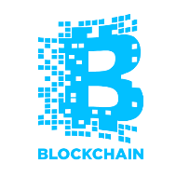
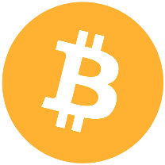
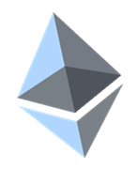
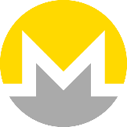
Blockchain Overview
Intro to Blockchain, Cryptocurrencies, Crypto Wallets, Exchanges, Smart Contracts and ICO
Svetlin Nakov
Technical Trainer
Academy School of Blockchain
http://kingsland.academy

Slide 2


Table of Contents
What is Blockchain?
Applications of the Blockchain Technology
Blockchain Networks, Mining, Consensus
Cryptocurrencies: Bitcoin, Ethereum, Others
Crypto Wallets: Software, Hardware, Online
Smart Contracts: Ethereum, Solidity, DApps
ICO (Initial Coin Offerings) / Token Sale Events
Corporate and Private Blockchain Networks
Blockchain for Developers: Challenges

Slide 3
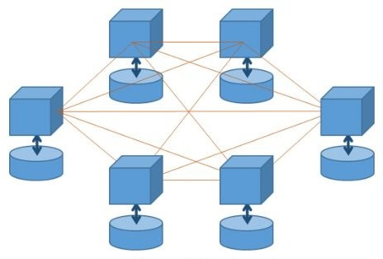
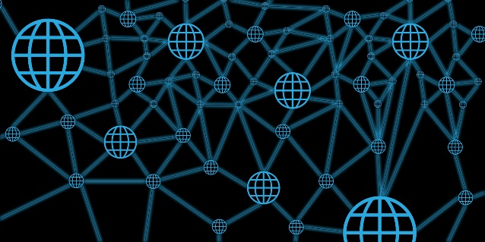
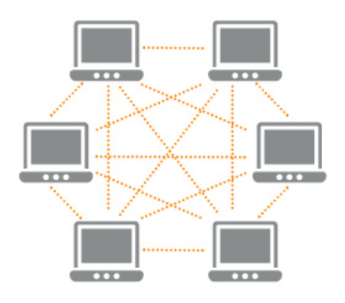
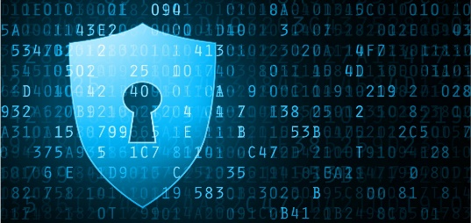
What is Blockchain?
Distributed ledger
Decentralized
(no owner)
Peer-to-Peer network
Secure
Immutable
Nodes hold ledger of facts + history of updates
Transactions are verified by the entire network

Slide 4
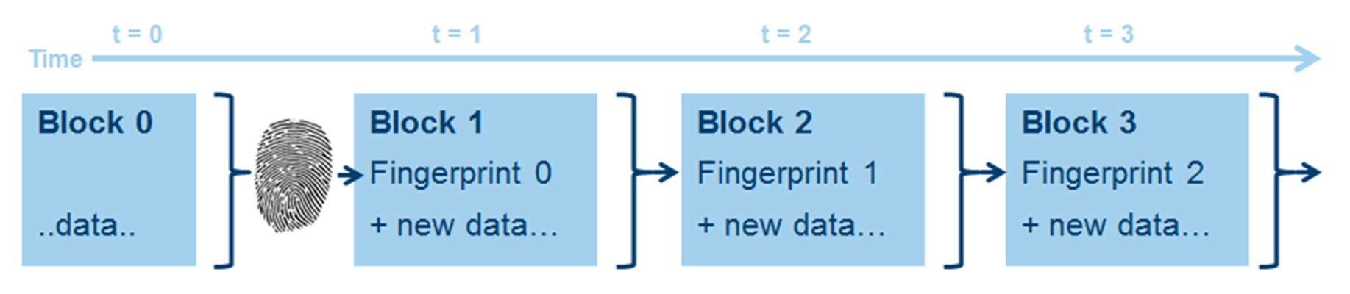
Blockchain == Chain of Data Blocks
Demo: https://etherscan.io
https://blockchain.info

Slide 5
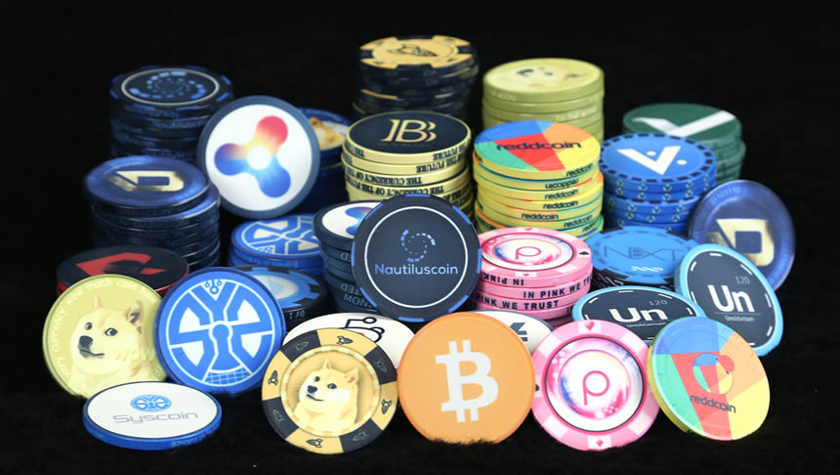
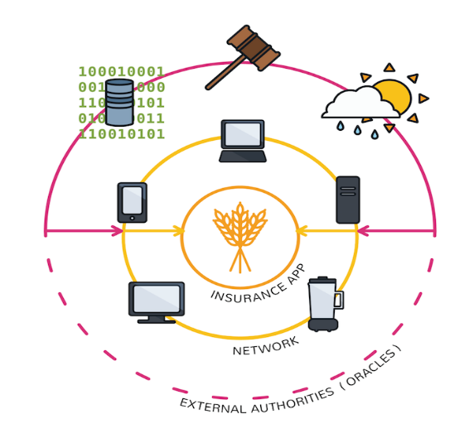
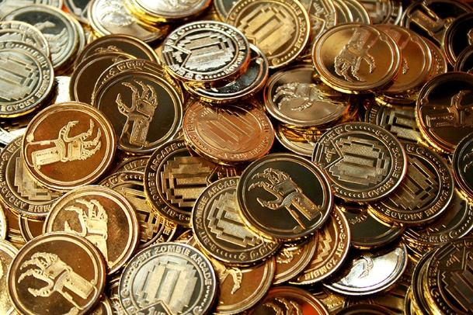
Applications of the Blockchain Technology
Decentralized applications
Cryptocurrencies
Digital investments
Digital money with no central bank
Fund raising / ICO / token sales
Removing the middlemen

Slide 6
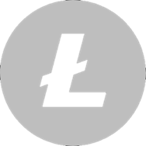
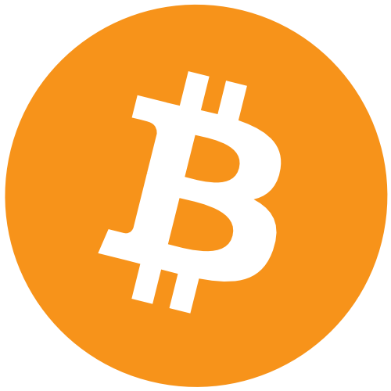
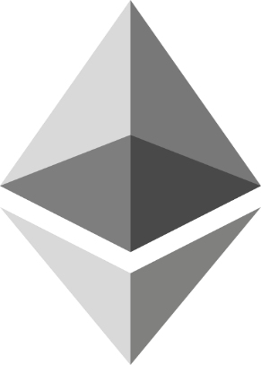
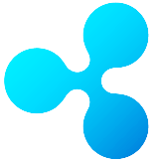
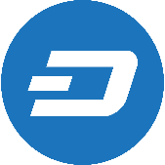
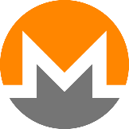
Blockchain Networks
Bitcoin
Ethereum
Litecoin
Ripple
Dash
The first famous blockchain cryptocurrency
The first famous smart contract platform
Monero
Demo: https://coinmarketcap.com

Slide 7
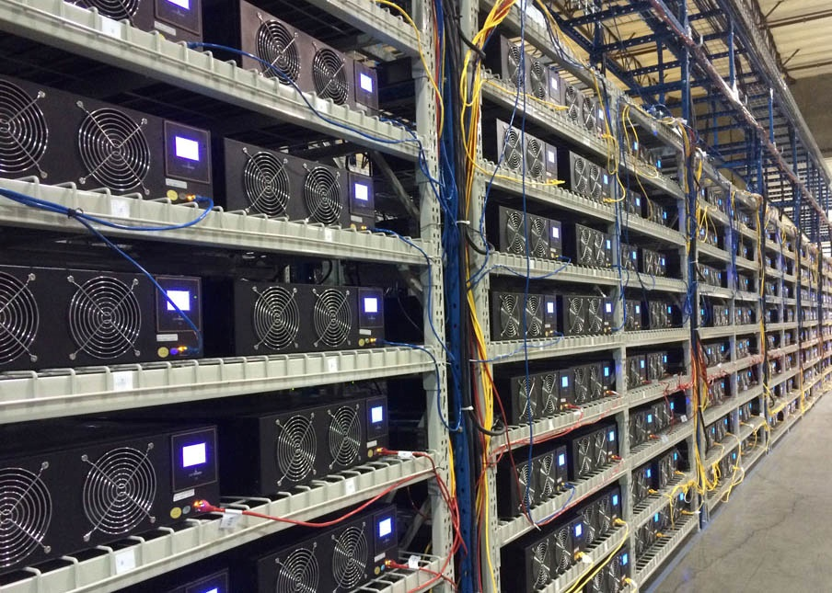

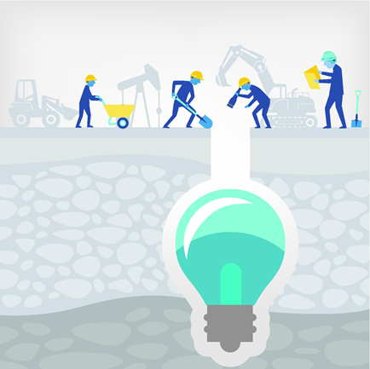
Miners, Farms and Pools
Mining farms
Miners: validate transactions + mine coins
Mining pools

Slide 8
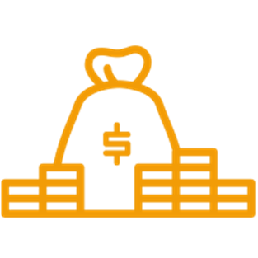

Consensus Algorithms
Proof-of-Work (PoW)
Proof-of-Stake (PoS)
Solve a crypto puzzle, to create the next block (uses lot of computations)
Choose the next block's creator based on wealth or age + some randomness

Slide 9
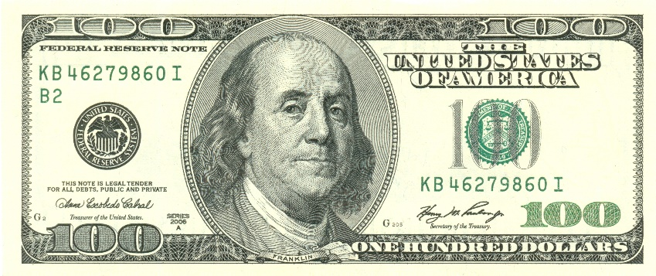
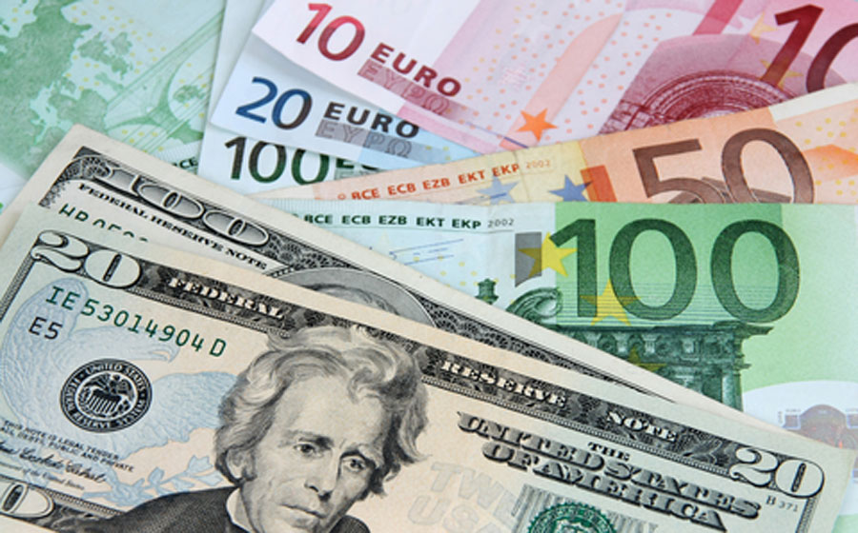
Traditional Money (Fiat Money)
Traditional (fiat) money: Guaranteed by the real economy + central bank + government + army
Example: USD Guaranteed by the US economy + government
US dollars are emitted by the US government

Slide 10
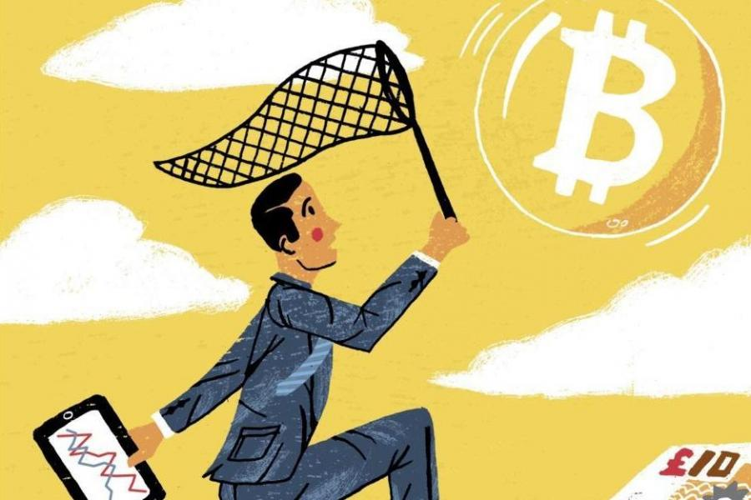
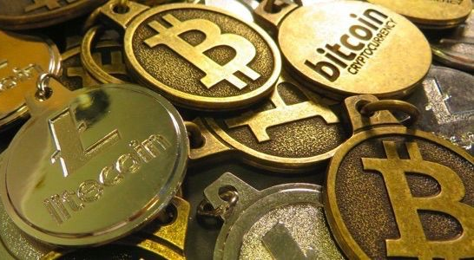
Cryptocurrencies
Example: Bitcoin The first decentralized crypto-currency
Crypto-money:
Not guaranteed, virtual, highly risky, volatile
Other examples: Ethereum, IOTA, Dash

Slide 11
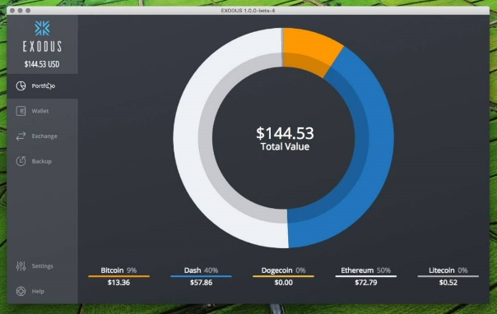
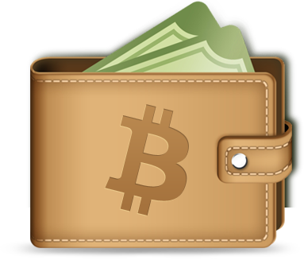
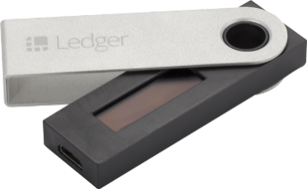
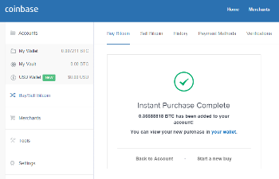
Crypto Wallets
Cryptocurrency wallets:
Store securely public and private keys of your blockchain assets
Software wallets
Hold multiple addresses + private keys
May hold BTC, ETH, ERC20 tokens, etc.
Hardware wallets
Online wallets

Slide 12
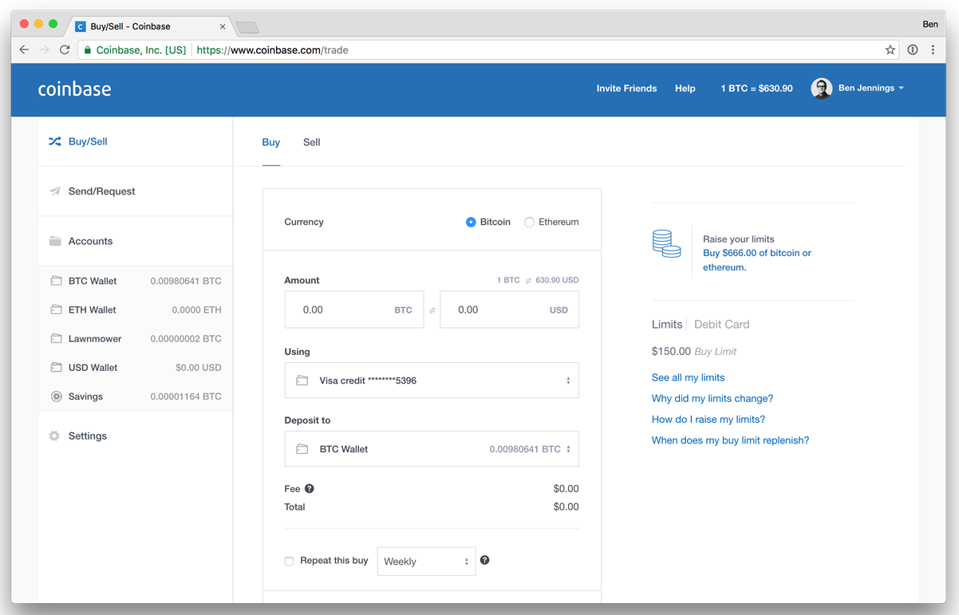

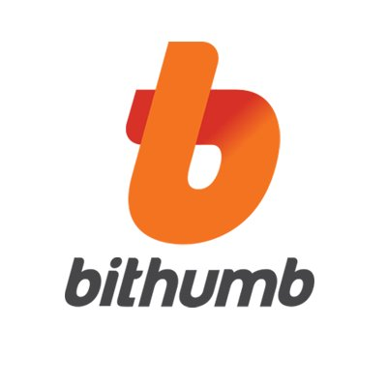
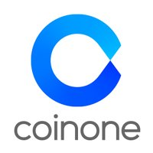
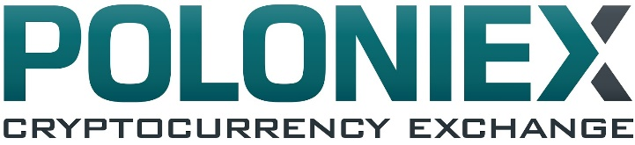
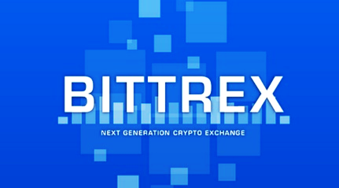



Cryptocurrency Exchange Services

Slide 13
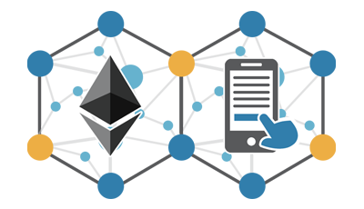
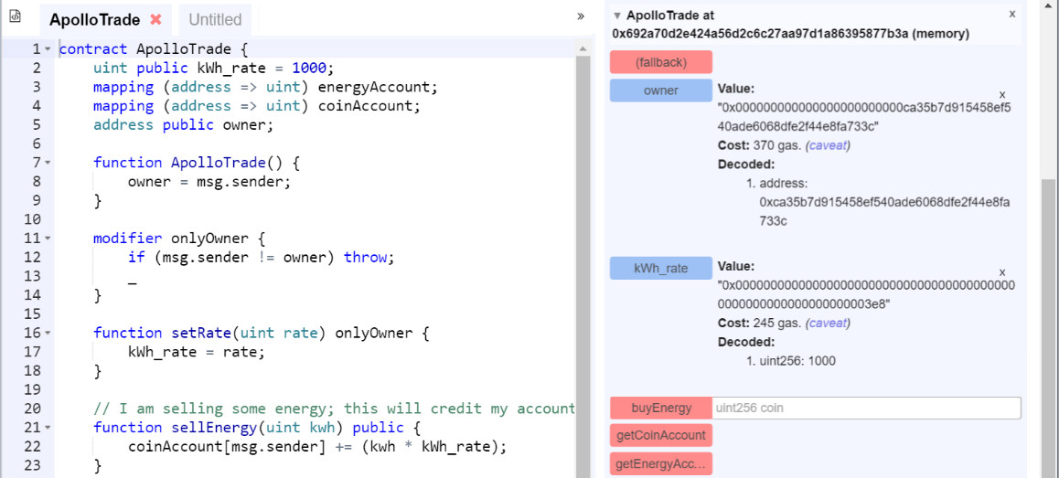
Smart Contracts
Smart Contracts
Code (custom logic) running in the blockchain network
Solidity
Blockchain programming language for the Ethereum network, running on EVM

Slide 14





How Do Smart Contracts Work?
Two blockchain addresses enter into a smart contract
The contract stays in the public ledger
Participants may be anonymous
A triggering event executes the contract code
The contract obligations are enforced (e.g. payments)
Everyone can see the contract activities
Contract actors may be anonymous

Slide 15
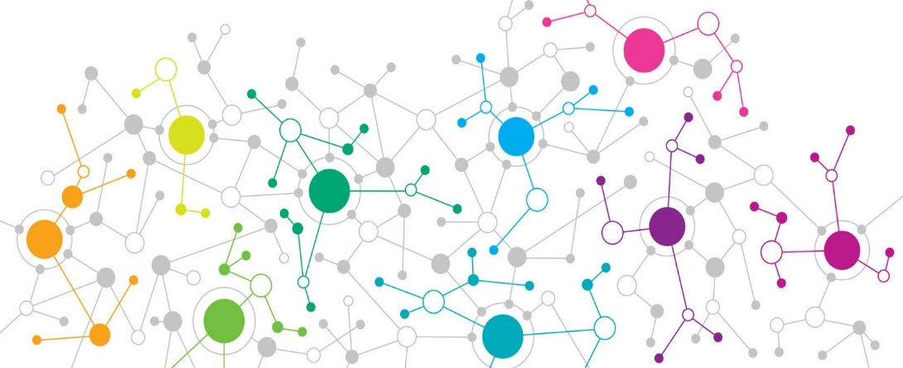
Decentralized Blockchain Apps (DApps)
DApps
DApps hold backend code and data on the blockchain
The front-end is still a traditional app
Client App (front-end)
Traditional Backend Server-side code + data
Smart Contract Backend Code + data on the blockchain

Slide 16
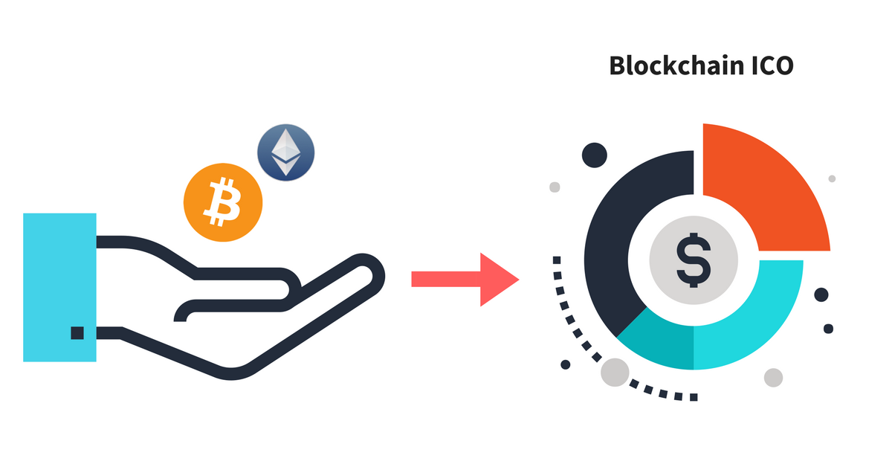
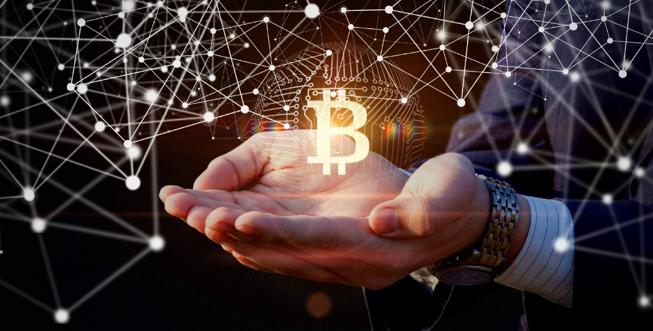
ICO / Token Sale Events
ICO (Initial Coin Offering)
Funds raised for a new cryptocurrency venture
Token Sale Events
Digital tokens raised through a smart contract
Examples: https://tokenmarket.net/ico-calendar

Slide 17
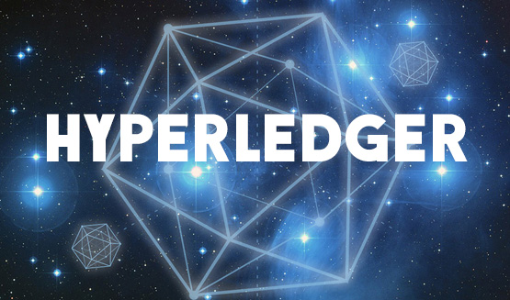
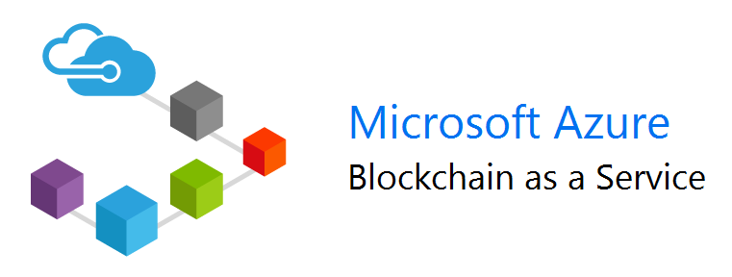
Corporate Blockchains
Hyperledger
Azure Blockchain
https://azure.microsoft.com/solutions/blockchain
Why Corporate Blockchain?
Public immutable ledger: trust between businesses + b2b smart contracts
https://www.hyperledger.org/members

Slide 18
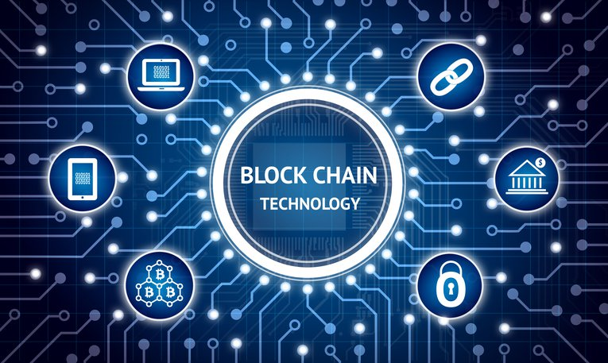
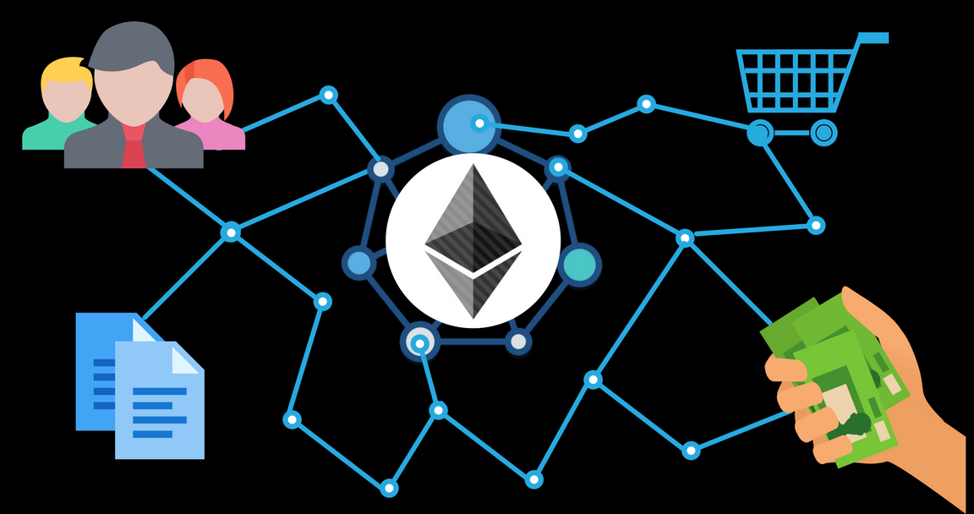
Blockchain for Developers
Build DApps
Implement smart contract logic in new / existing apps
Build New Blockchain Networks or Technologies
Startups and Innovations

Slide 19
Blockchain Projects and Technologies
Project | Languages | URL
Bitcoin Core | C++, C | https://github.com/bitcoin/bitcoin
Ethereum | Go (primary), Rust, C++ | https://github.com/ethereum
IOTA | Java | https://github.com/iotaledger/iri
Cardano | Haskell | https://github.com/input-output-hk/cardano-sl/
Bitcoin Cash | C++, C | https://github.com/Bitcoin-ABC/bitcoin-abc
Lisk | JavaScript | https://github.com/LiskHQ/lisk
NEO | C# | https://github.com/neo-project/neo
Stellar | C++ | https://github.com/stellar/stellar-core
Ripple | C++, C | https://github.com/ripple/rippled

Slide 20
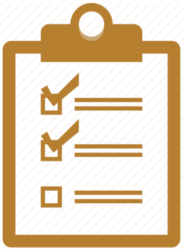
Summary
Blockchain is a decentralized distributed ledger
Based on cryptographically signed chain of blocks holding transactions
Consensus algorithms like proof-of-work (PoW)
Allow miners to achieve consensus, validate transactions and mine coins
Cryptocurrencies are decentralized digital crypto money
Bitcoin, Ethereum, Dash, Monero, IOTA
Smart contracts are executed in the blockchain
Hold data and program logic on the blockchain
Blockchain developers build DApps / blockchain software

Slide 21

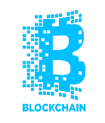
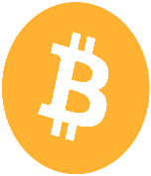

Blockchain Overview
http://www.kingsland.academy

Slide 22
Resources
IBM Blockchain 101 – Infographic: https://www-01.ibm.com/common/ssi/cgi-bin/ssialias?htmlfid=XI912346USEN
Ethereum Blockchain Explorer: https://etherscan.io
Bitcoin Block Explorer: https://blockchain.info
Cryptocurrency Market Capitalizations: https://coinmarketcap.com
What are Bitcoin Mining Pools? https://www.coindesk.com/information/get-started-mining-pools

Slide 23
Resources (2)
Proof-of-Work (PoW): https://en.wikipedia.org/wiki/Proof-of-work_system
Proof-of-Stake (PoS): https://en.wikipedia.org/wiki/Proof-of-stake
Crypto Wallets and Best Bitcoin Wallet - Ultimate Guide: https://www.buybitcoinworldwide.com/wallets
Comparison of Cryptocurrency Exchange Services: https://en.bitcoin.it/wiki/Comparison_of_exchanges
Smart Contracts Explained: http://www.blockchaintechnologies.com/blockchain-smart-contracts

Slide 24
Resources (3)
Decentralized Apps (Dapps) and the Decentralized Future: https://captainaltcoin.com/decentralized-apps-dapps
Definition of Initial Coin Offering (ICO): https://www.investopedia.com/terms/i/initial-coin-offering-ico.asp
ICO Calendar: https://tokenmarket.net/ico-calendar
IBM Blockchain 101: Quick-Start Guide for Developers: https://developer.ibm.com/blockchain/resources/ibm-blockchain-101-quick-start-guide-developers
Azure Blockchain: https://azure.microsoft.com/solutions/blockchain

